Slide 1
Digital Photography
Adjusting Color with White Balance Settings
Mr. Sandoval
Mission Vista High School

Slide 2
Of major importance when using a digital camera is…getting the colors in your photographs just the way you want
But to get beautiful colors you need to choose the correct white balance setting…

Slide 3
Have you ever noticed how people look greenish in a picture if the room was lit with florescent lights?

Slide 4
This type of problem can be solved easily when you use the flash & correct white balance settings

Slide 5
In This Lesson You Will Learn
What color temperature is
How it affects color in the photography
What white balance means
Why it is important
How to choose between automatic, preset, and custom white balance settings

Slide 6
Color Balance
Color balance refers to rendering colors produced by cameras and other electronic devices
White Balance is the process of removing unrealistic color casts
So objects that are white remain white

Slide 7
What the Camera Sees
An incorrect WB can create unsightly blue, orange, or even green colors
Proper camera White Balance has to take into account the “color temperature” of a light source

Slide 8
Adjusting White Balance
Fluorescent lighting adds a bluish cast tungsten (incandescent/bulbs) lights add a yellowish tinge
Different digital cameras have different ways of adjusting white balance
Many digital cameras have automatic and semi-automatic modes to help you make the adjustments

Slide 9
Basic White Balance Settings
Auto - this is where the camera makes a best guess on a shot by shot basis
Tungsten - Is for shooting indoors – using bulb lighting
Cools down the colors in photos
Fluorescent - this compensates for the ‘cool’ light of fluorescent light
Warms up your shots

Slide 10
Continued
Daylight/Sunny - not all cameras have this setting
sets things as fairly ‘normal’ white balance settings
Cloudy - this setting generally warms things up a touch more than ‘daylight’ mode
Flash - the flash can be quite a cool light so in Flash WB mode warms up your shots a touch
Shade - the light in shade is generally cooler (bluer) than shooting in direct sunlight so this mode will warm things up a little
Let’s look at the Quick Reference – page 167

Slide 11
Manual White Balance Adjustments
In most cases you can get a pretty accurate result using the white balance modes
Some digital cameras allow for manual white balance adjustments
In this mode you tell your camera what white looks like in a shot (reference point)
To do this by buying a white card which is specifically designed for this task
Or you can find some other appropriately colored object around you to do the job

Slide 12
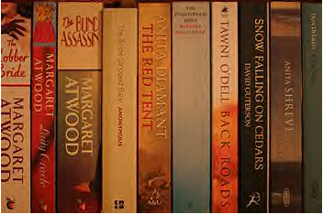
How It Looks
The first shot are some books on a shelf taken in Auto White Balance mode
The room is lit by 3 standard light bulbs and as a result the image is quite warm or yellow

Slide 13
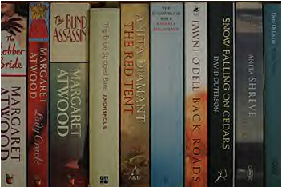
Next Shot
Next, a white piece of paper is held to the camera to tell it what color white is
Then a 2nd shot is taken with the following result - which you’ll see is a much truer color cast than the first image
Let’s learn the specifics of how to make changes with your camera

Slide 14
Color Casts
When an image has a ‘color cast’ the color are not ‘true’
It is like viewing an image through color glasses

Slide 15
Working with Color Temperature, Light Sources, & Color Cast
Approx Color Temperature | Light Source | Color Cast
1000-2000K | Candlelight, firelight | Very red
2000K | Sunrise, sunset | Less red, more orange
2500K | Incandescent bulbs, standard light bulbs | Less red
3300K | Studio lights | Tinge of red
5000K | Standard daylight | None, neutral
6500K | Bright sun, clear skies | Tinge of blue
6000-7000K | Somewhat overcast skies | Bluer
9000K | Shade | More blue
10,000K | Very Overcast | Very blue
K = Kelvin Scale

