Slide 1
Understanding Aperture (a beginner’s guide)

Slide 2
What is Exposure?
Exposure is basically the AMOUNT OF LIGHT (controlled by the aperture) that is captured over a SPECIFIC AMOUNT OF TIME (controlled by the shutter speed).

Slide 3
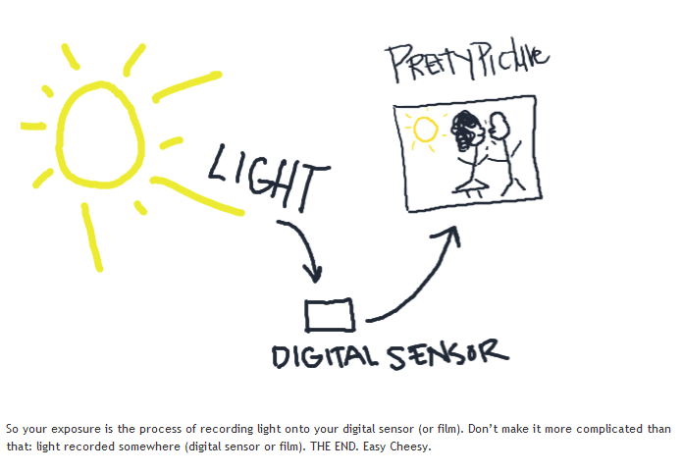

Slide 4
What is Aperture
Your aperture, or your F-stop, controls how much light hits your sensor.
A lens’s aperture (fstop) is basically a hole that opens to let in more light and closes to let in less light
The larger the “HOLE” or aperture (fstop), the more light will hit your sensor, the smaller the “HOLE” or aperture (fstop) the less light will hit your sensor.

Slide 5
QUIZ
Which aperture (fstop) is going to let in more light? f2.8 or f4
ANSWER:
f2.8 Remember the smaller the number the larger the “hole” and thus more light entering the camera to be recorded by your digital sensor

Slide 6
TRUE apertures
The TRUE apertures are as follows (called fstops):
There are third “stops” in between, your camera may or may not have these
Range of most lens
Let’s look at your manuals

Slide 7
Last word about aperture: Your aperture (fstop) that controls the depth of field in a photo

Slide 8
Depth of Field….
Is basically the amount of an image that is in focus.
An image with a very deep depth of field would be an image where everything is in focus
While an image with a very shallow depth of field would have a lot of “fall off” or BLUR with only one segment of the image in focus

Slide 9
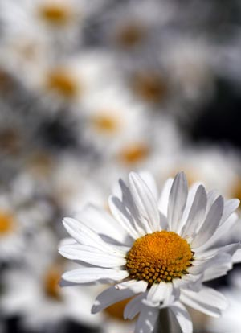
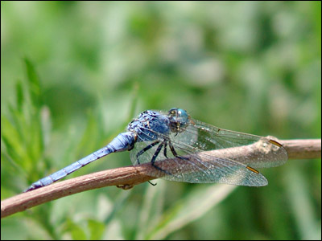
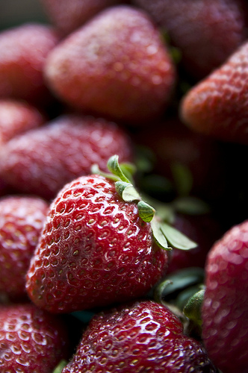
Samples of Depth of Field

Slide 10
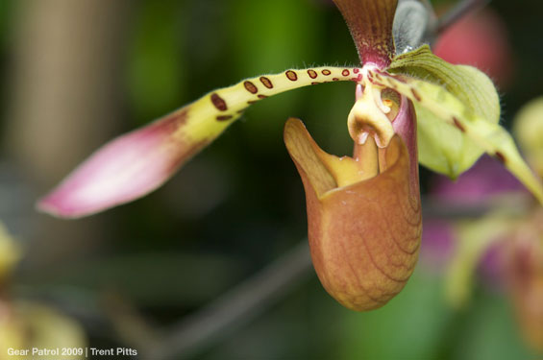
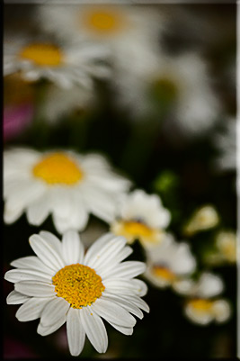
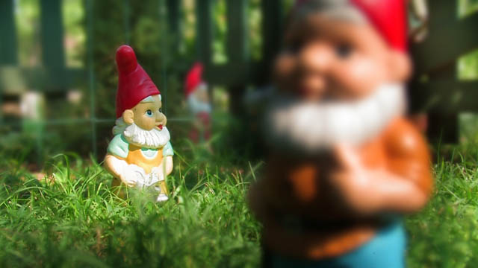
Samples of Depth of Field

