Slide 1
How To Hold A Digital Camera
http://digital-photography-school.com

Slide 2
Common Problems
One of the common problems that many new digital photographers have is ‘camera shake’
Not holding the camera still enough while the shutter was depressed
This is especially true when taking shots in low light situations where the shutter is open for longer periods of time
Many times the only way around this problem is with a tripod

Slide 3
Another Problem
When digital camera users hold the camera at arms length away - often with one hand
While this might be a good way to frame your shot
You have more of a chance to sway or shake as you take your shot

Slide 4
Solutions
Simple way to enhance the stability is to hold the camera with 2 hands
While it can be tempting to shoot one handed… with 2 hands you will increase your stillness
Just like a tripod 3 legs are being better than one
Tripods are the best way to stop camera shake because they have 3 sturdy legs that keep things very still

Slide 5
Gripping Your Camera
Luckily for us there is no real right or wrong way
Exactly how you should grip your camera depends on the camera
Varies from person to person

Slide 6
Where to Start
Use your right hand to grip the right hand end of the camera
Forefinger should sit lightly above the shutter release
Other 3 fingers curling around the front of the camera
Right thumb grips onto the back of the camera
Most cameras have some sort of grip where fingers should naturally go
Use a strong grip with your right hand but don’t grip it so tightly that you end up shaking the camera

Slide 7
Holding the Camera
The left hand should support the weight of the camera, sitting underneath the camera or under/around a lens
If you’re shooting using the LCD make sure you don’t hold your camera too far away from you
Tuck your elbows into your sides and lean the camera out a little from your face
Add extra stability by leaning against a solid object like a wall or a tree or by sitting or kneeling down
If you have to stand without support put your feet shoulder width apart to give yourself a steady stance
The stiller you can keep your body the stiller the camera will be

Slide 8
Another Quick Bonus Tip
Before you take your shot
Take a gentle but deep breath
Hold it
Then take the shot and exhale
Or do the exact opposite - exhale and before inhaling again take the shot
Use the technique that is most comfortable for you

Slide 9
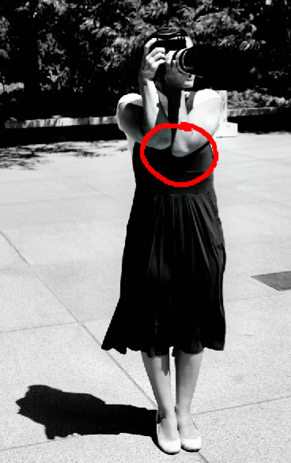
How Professionals Stand
When you’re working with a wide aperture and/or low shutter speed even a breath can introduce shake
As often as possible pull your elbows in to your body and exhale completely before depressing the shutter

Slide 10
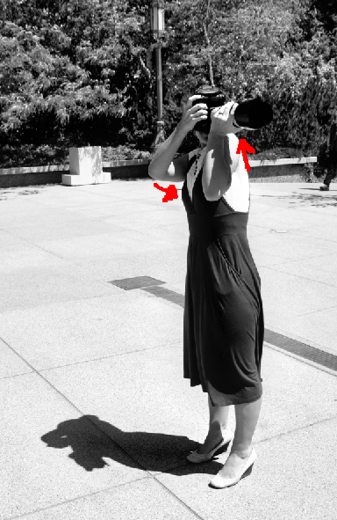
Raise Your Left Shoulder….
From expert Joe McNally in “The Moment It Clicks” try shifting for a moment to look through your left eye
Then raise your left shoulder & bracing your left elbow into your rib-cage
For further stability, you can pull your right elbow in to your chest
Then exhale completely before depressing the shutter to avoid introducing shake

Slide 11
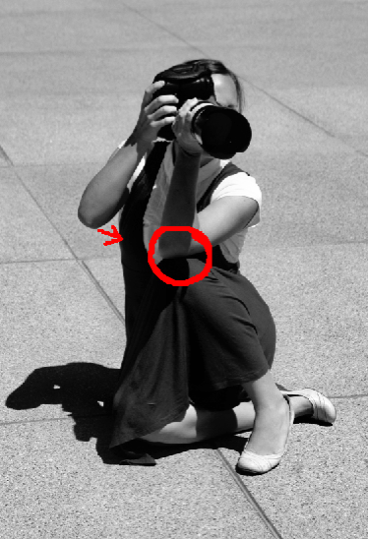
Create a Tripod With Your Knee
You can create your own tripod by resting your elbow on your knee while in a seated position
AND again, bring that other elbow in for greater support

Slide 12
Lay Down
Lie flat and let the lens sit directly on the ground
The to improve this stance, place your fist under the camera to give it greater height

Slide 13
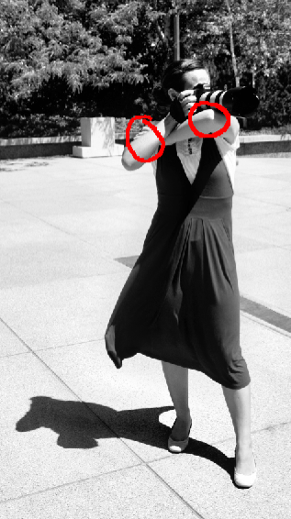
The Machine Gun Hold
This technique can be awkward and difficult to maintain for more than a second or two
Stand with one leg in front, hold the camera in the nook of your arm

Slide 14
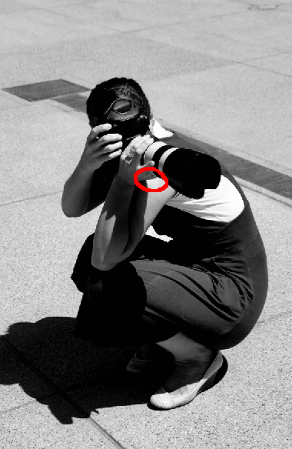
Cradle It
In this image you’ll see that the photographer has created a sort of cradle for the lens between their shoulder and wrist
Then to add additional stabilization, balance your elbow on your knee

