Slide 1
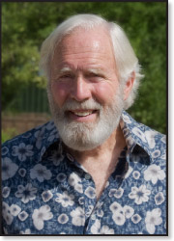
David Muench
By Alissa Slevin

Slide 2
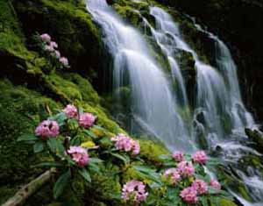
Background
Born on June 25, 1936 in Santa Barbara, California.
Became a landscape photographer.
He is one of the most respected landscape and nature photographers in the world.
His father was a well known photographer named , Josef Muench .
He learned mostly everything from his father about landscape photography.

Slide 3
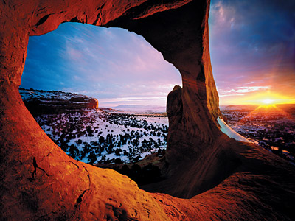
Accomplishments
First photographs published in covers of Arizona Highways.
Attended many different schools.
Devoted his time capturing the beauty of the west coast.
Freelancer for more than 50 years.

Slide 4
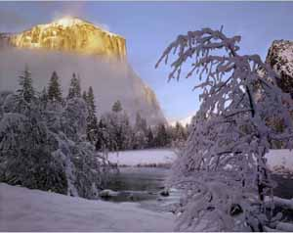
Credos
“For me, making photographs is always a total and continuing involvement,” he says.
Underlying my need to express a spirit of the land are certain patterns of discovery and exploration.

Slide 5
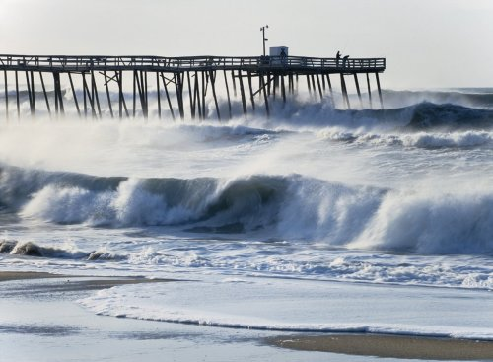
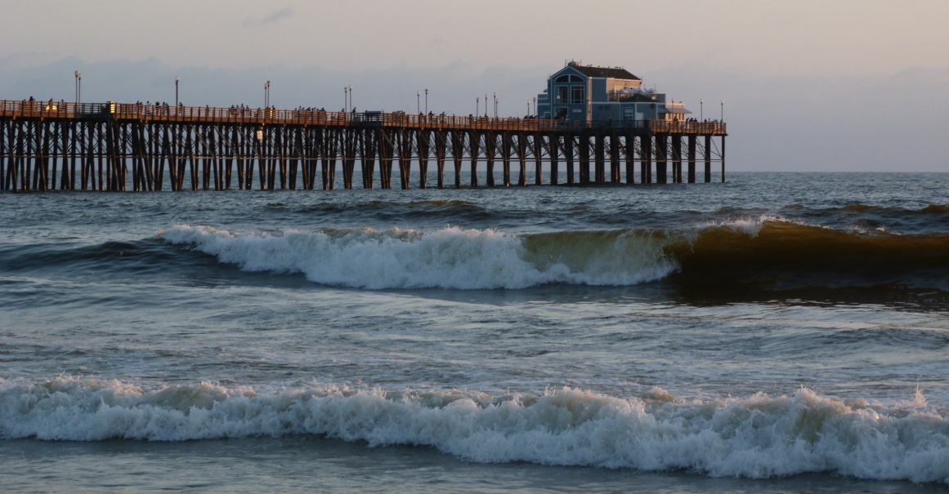
Imitations of David's Muench pictures.
David’s work
My work

Slide 6
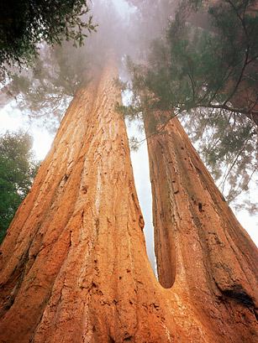
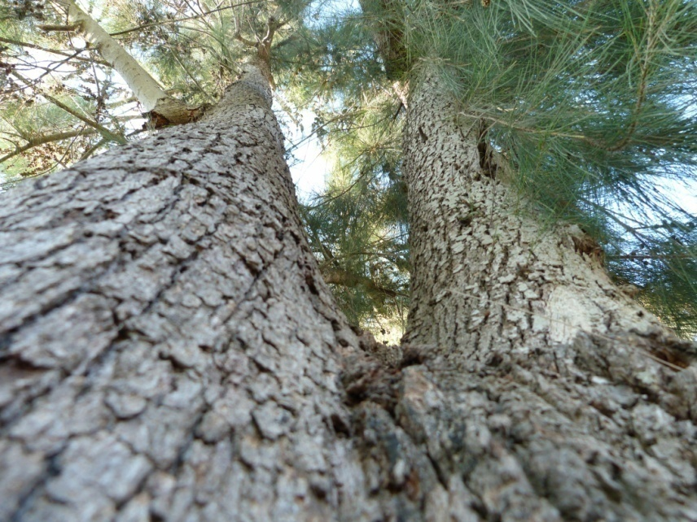
Imitations of David’s Muench pictures 2
David’s work
My work

Slide 7
The End

