Slide 1
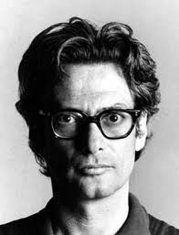
By Monika Cortez
Richard Avedon

Slide 2
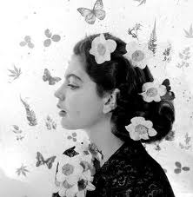
Background
His first photography job was for Merchant Marines taking ID pictures for the crewman.
In 1994 an art director for a fashion magazine discovered his work.
Was a model photographer for most of his career.

Slide 3
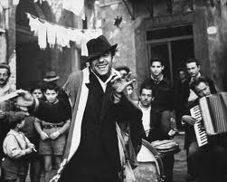
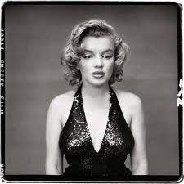
Photographic beliefs
Are mainly people with intense face expressions
Black and white
Believes that “The camera lies all the time”.

Slide 4
History
Made a living by taking pictures for most of the 1900’s.
1992 he became first staff photographer for The New Yorker.
later published a book called “In The American West” in 2003.
October 4, 2004 Richard died of a brain hemorrhage in Texas.

Slide 5
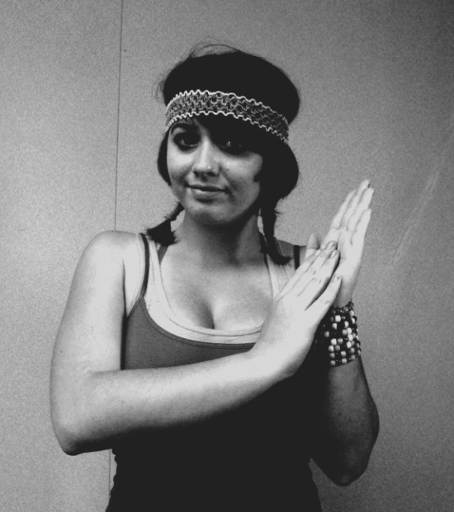
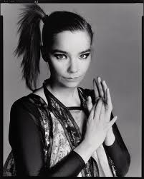
Imitations
My Imitation.
Richard’s Photo.

Slide 6
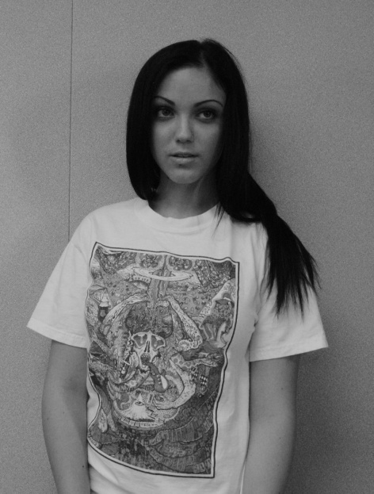
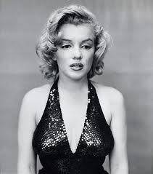
Imitations cont.
RICHARD’S PHOTO
MY IMITATION

